Slide 1
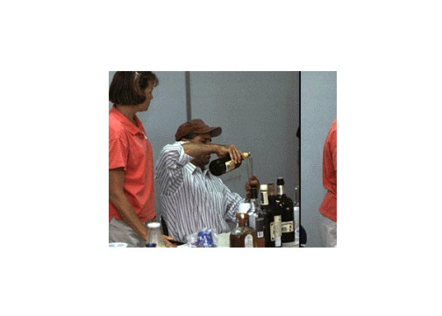



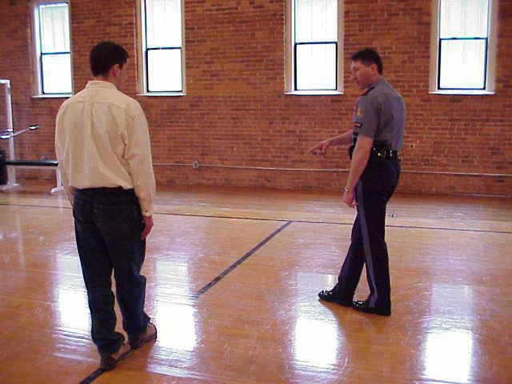
Session 5
Alcohol Workshop

Slide 2
Learning Objectives
Administer psychophysical tests and eye examinations to persons who have consumed varying amounts of alcohol
Document results of tests and examinations
Accurately assess extent of alcohol impairment based on tests and examinations

Slide 3
Team Assignments
One member will be an examiner
One member will be the recorder
All others in group will observe/coach
Each team member will conduct at least one complete examination

Slide 4
Testing Procedures
HGN (record onset angle in each eye)
VGN
LOC
MRB
WAT
OLS (left foot and right foot)
FTN

Slide 5
Testing

Slide 6
Questions?

